Slide 1
Same Day Surgery
Preparation Book

Slide 2
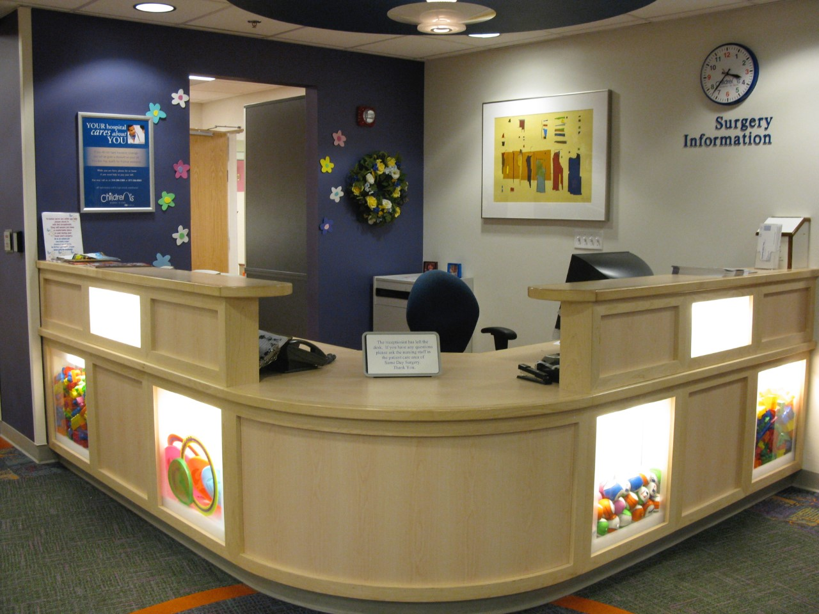
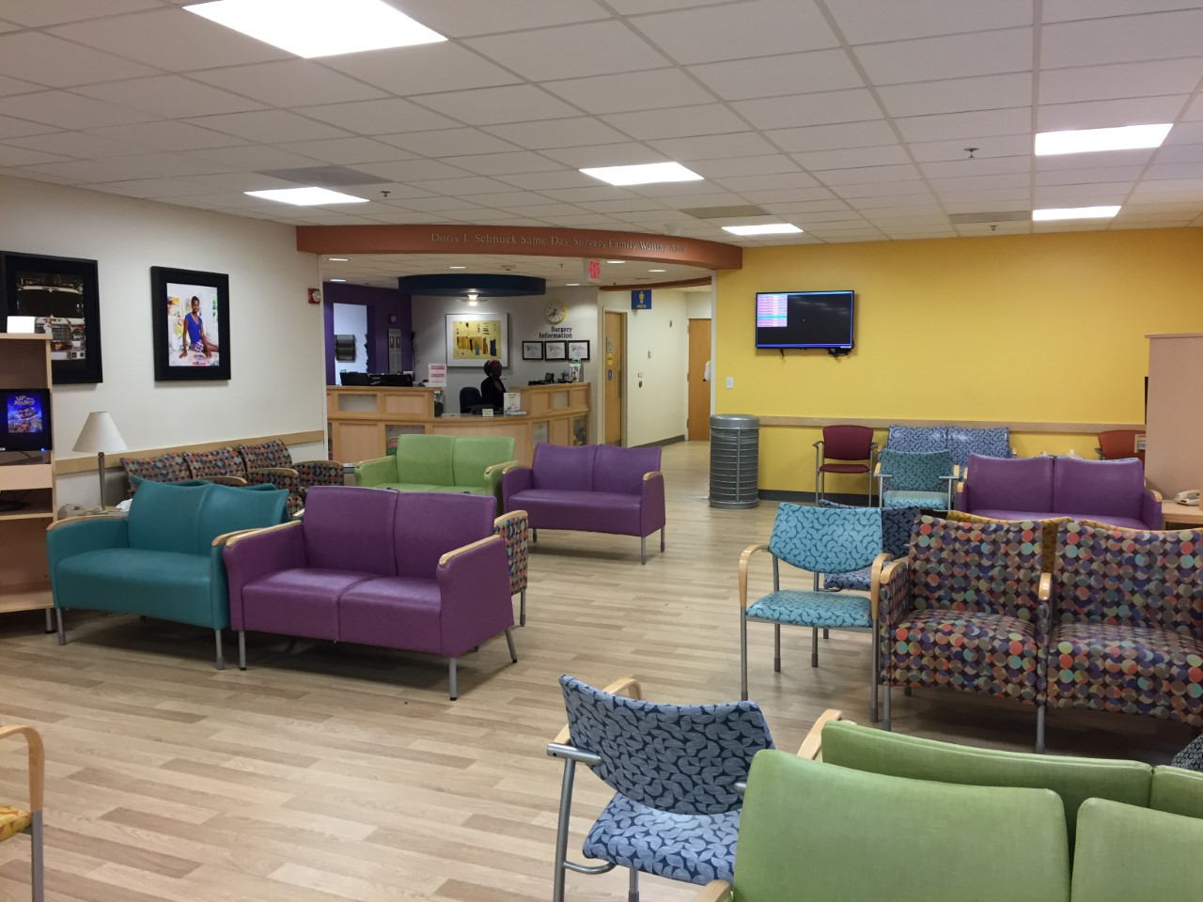
Welcome to Same Day Surgery
When you arrive on the 6th floor, you and your family will check in at our front desk.
You will sit in our waiting room until the nurse calls your name

Slide 3
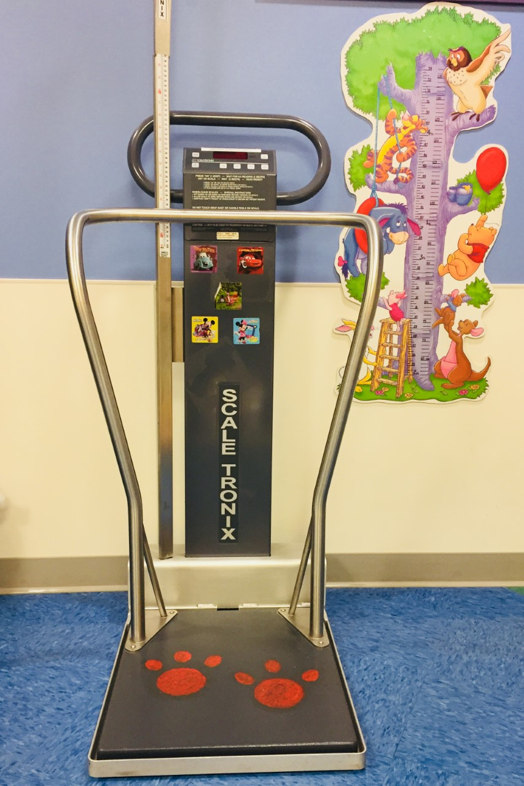
Checking IN
When you come in from the waiting room, you will stop at our scale. The nurse will measure how tall you are and how much you weigh
The nurse will check your temperature with a special thermometer that moves across your forehead

Slide 4
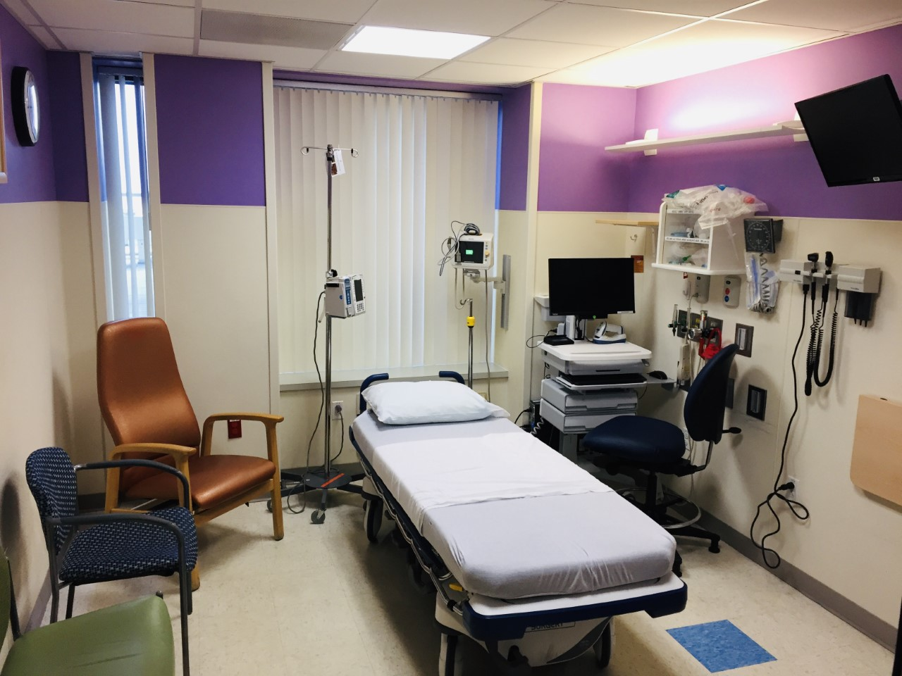
While you Wait for surgery
This is the room you will be in while you wait for surgery. You will meet the doctors and nurses on your team. They will talk to you about falling asleep for surgery and what surgery will be like for you. They will ask you lots of questions and listen to your heart and lungs with a stethoscope

Slide 5
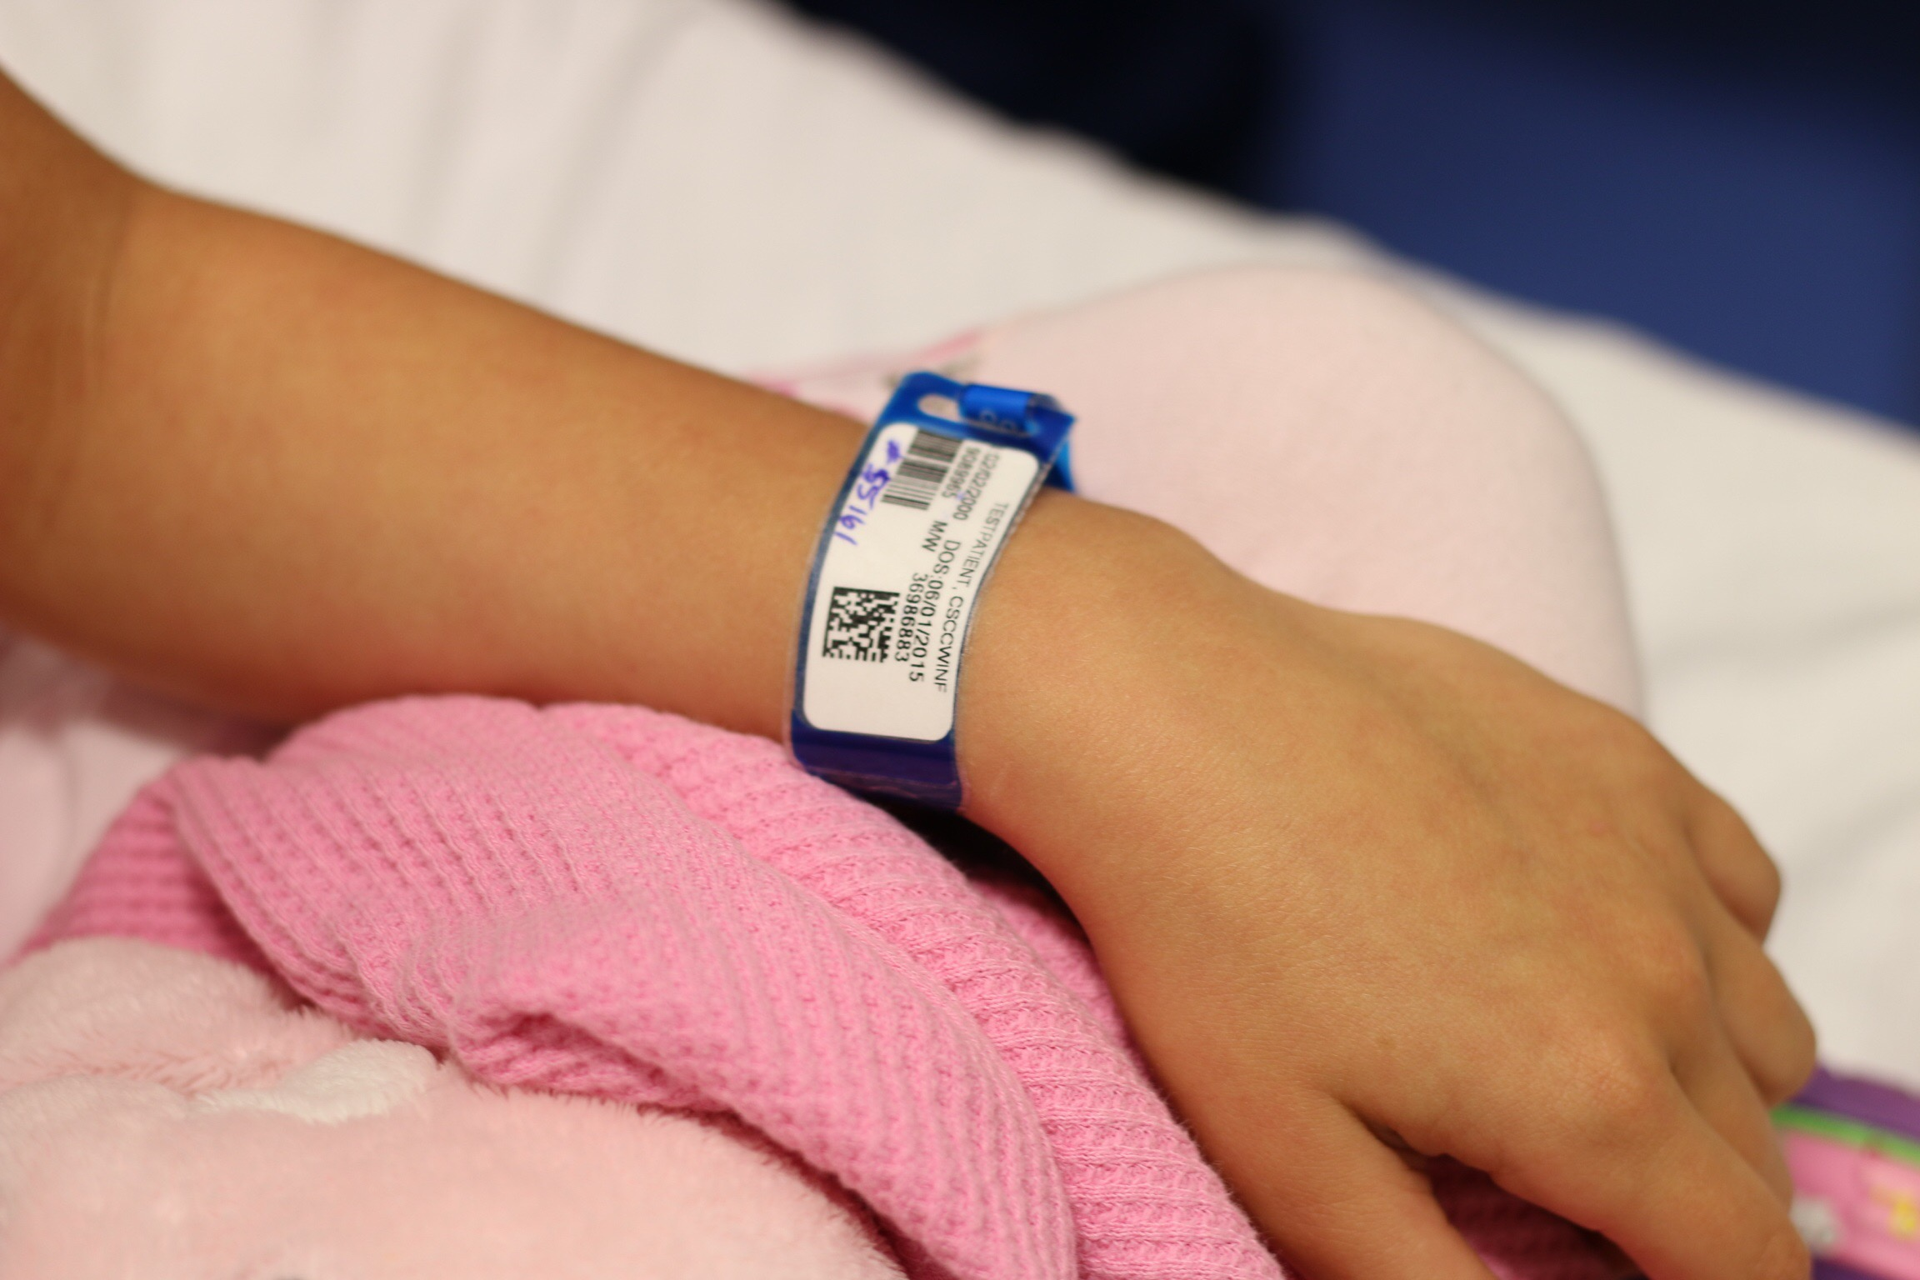
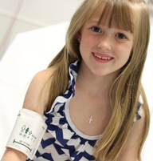
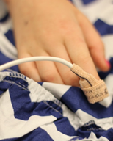
Your nurse will give you a special bracelet to put on your arm or ankle. This bracelet tells us who you are and when your birthday is
This is the blood pressure cuff. It gives your arm a tight hug
This is called a pulse ox. It is a special bandaid that goes around your finger

Slide 6
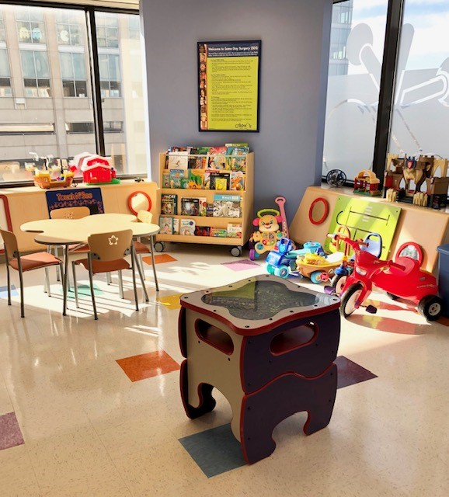
Time to play
While you are waiting for surgery, you can play in our play area or take some toys back to your room with you. We have coloring sheets and crayons available also

Slide 7
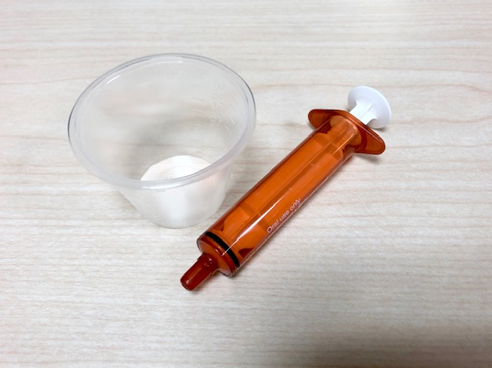
medicines
You might need to take some medicines before your surgery to help you feel better. There is one medicine called Versed that can help you relax. It can make you feel a little sleepy or silly. Other medicines do not make you feel sleepy or silly but will help you feel better after your surgery. You can drink your medicine from a cup or syringe

Slide 8
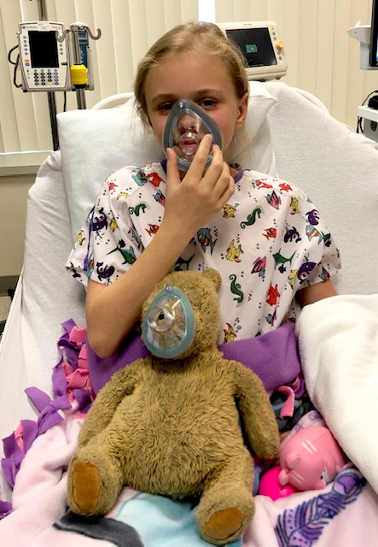
Anesthesia Mask
Here is a patient and her teddy bear practicing taking deep breaths with her mask before surgery. You will need to take big deep breaths with the mask. You can pretend to blow out candles or blow up a balloon. You can also count or pretend you are somewhere fun that you like to go. We can put a special smell in your mask. Ask us what our flavor choices are

Slide 9
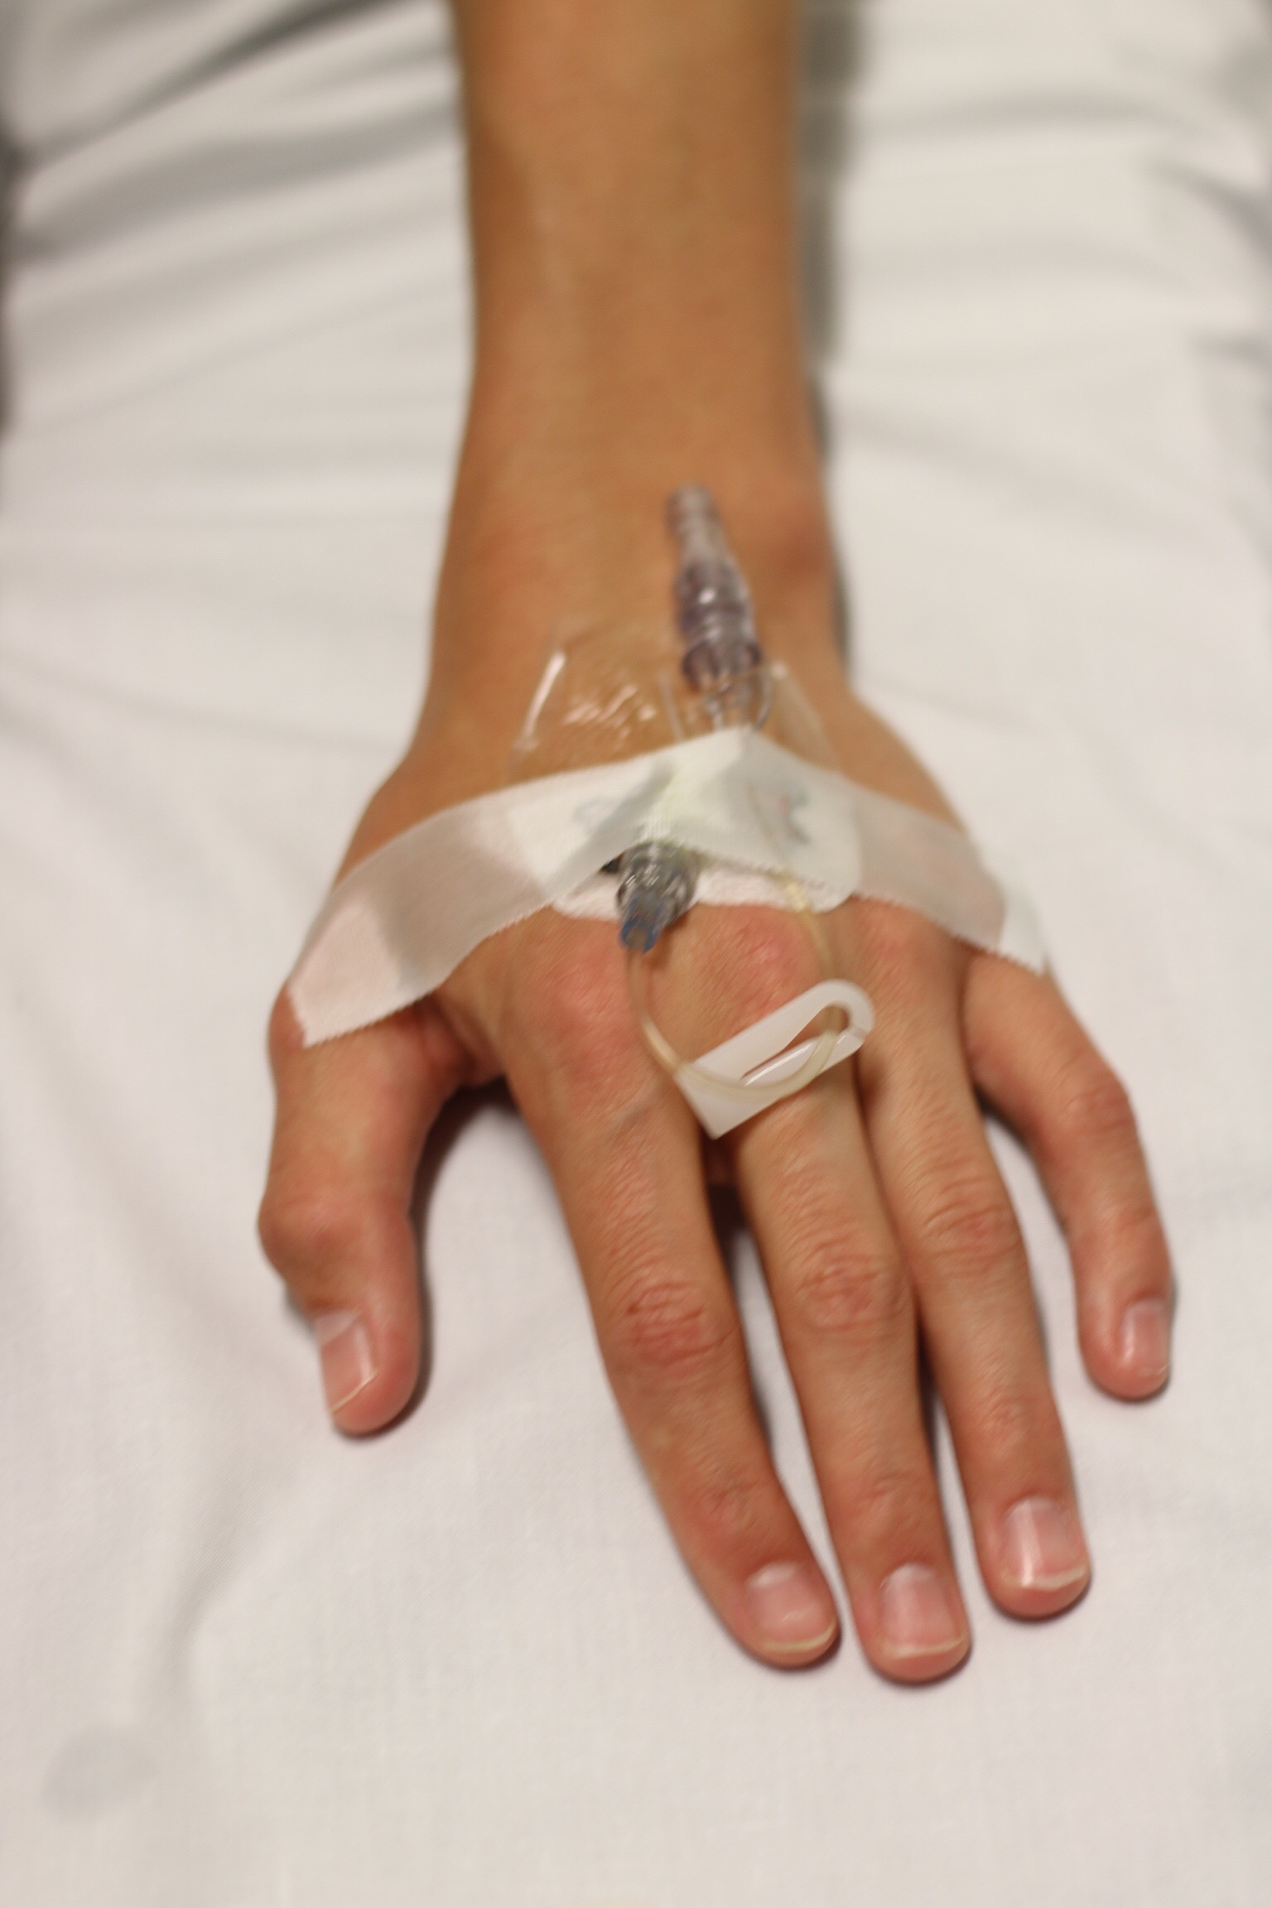
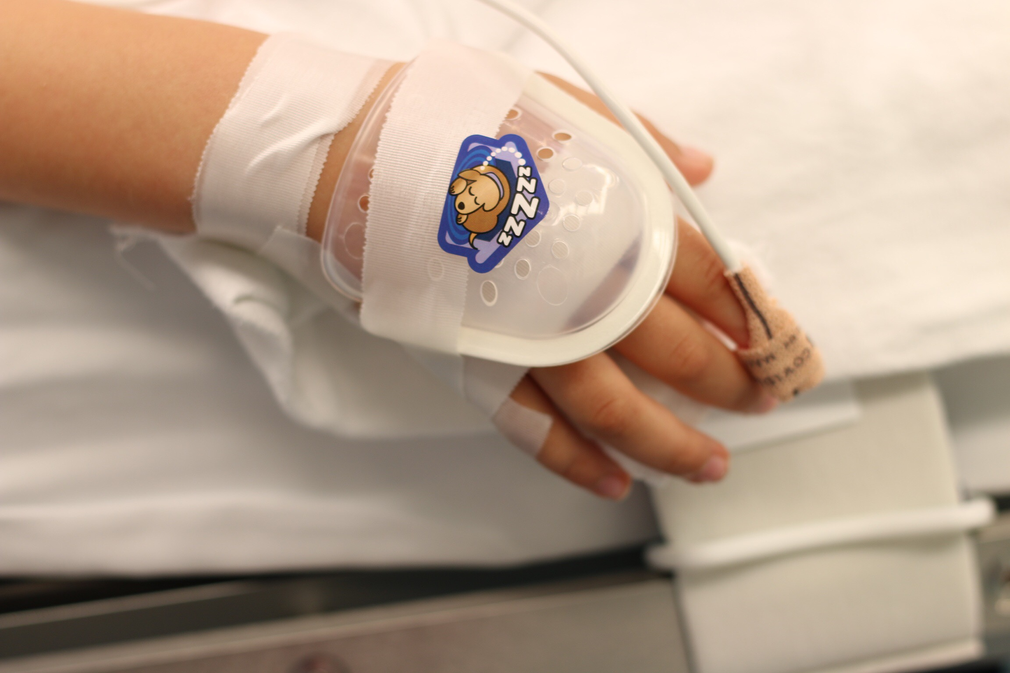
I.V.
You might need an I.V. before you go for surgery. An I.V.is a tiny straw that goes into your veins. This straw will give your body the medicine it needs to fall asleep for surgery. It also gives your body water to drink and special medicine to help you feel better after you are done. There will be tape on top of your i.v. to hold it in place. You may have a plastic cover over it and a white pillow under your arm and hand to keep it safe

Slide 10
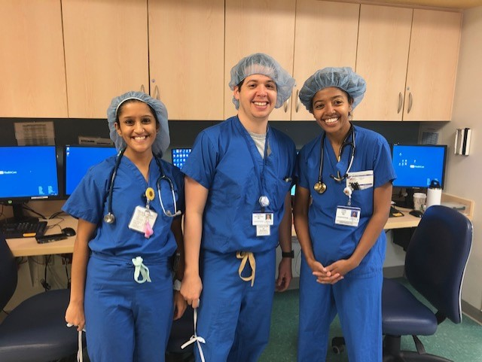
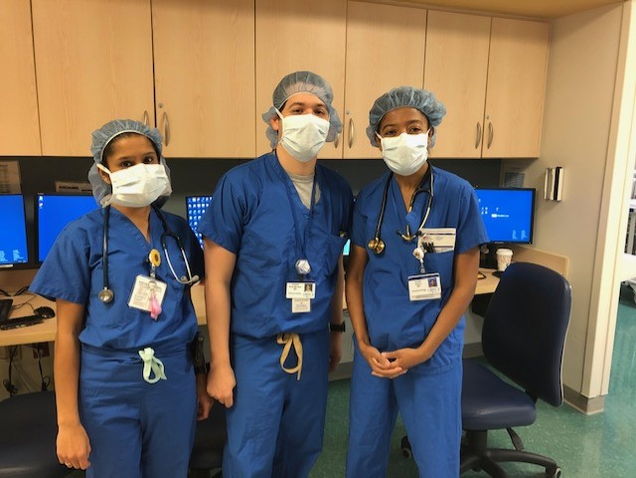
Staff Clothes
The doctors and nurses that will be with you during your surgery will be wearing blue clothes called scrubs. They are like pajamas. They also wear hats which can be colorful or just plain blue. Some hats you will see are big and puffy and other hats are smaller. The doctors and nurses will also wear a mask that will cover their nose and mouth. They can still smile and talk through their mask even though you cannot see their mouths. The doctors and nurses wear all of this to keep you safe from germs and keep you healthy

Slide 11
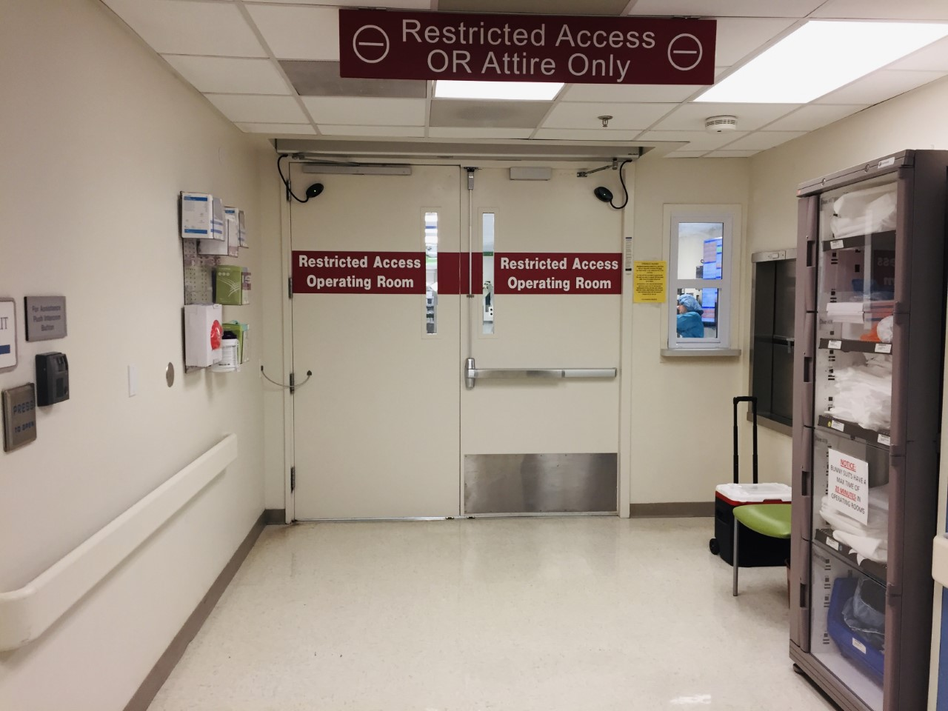
These are the doors you will go through with the doctors or nurses to get to your operating room. Because you are wearing your special pajamas, you are able to go through these doors. Before you go to the operating room you can give your family lots of hugs and kisses and tell them you will see them in a little while. Don’t forget to bring your special stuffed animal or blanket

Slide 12
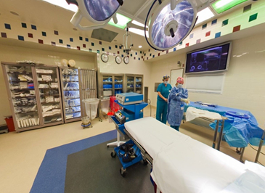
The Operating room
The operating room is where you will have your surgery. There is a lot of equipment in this room, but not everything is used for you. We store lots of equipment in here so we have everything we need for every patient that comes to see us. The operating room can be a little cool, so you will get a warm blanket to cover up with

Slide 13
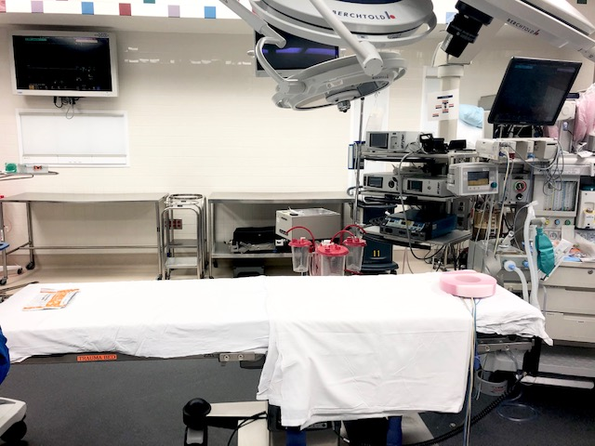
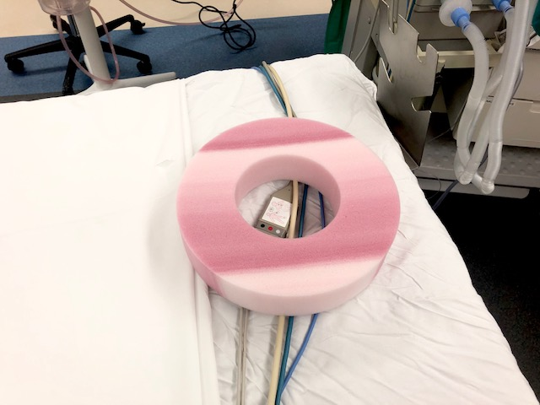
The Operating room
This is the bed where you will fall asleep for your surgery
You will rest your head on a special pillow that looks like a strawberry doughnut

Slide 14
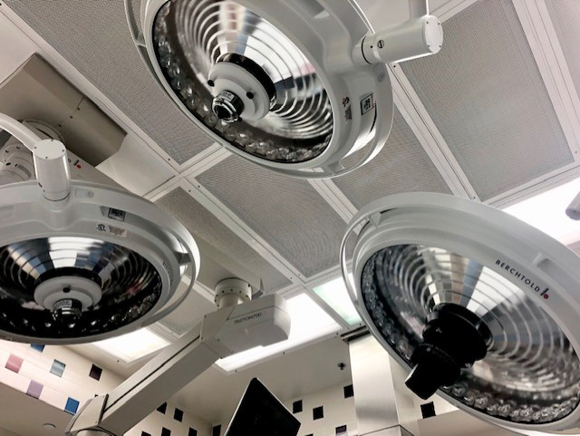
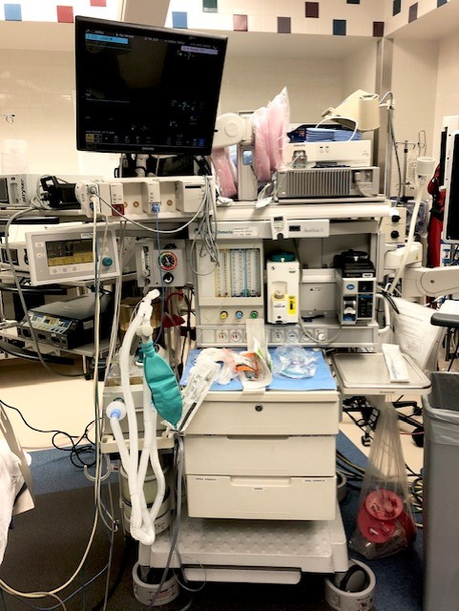
The Operating room
You will see big round lights above your bed. These lights help the doctors to see you better
This is the machine that gives you your sleepy medicine and helps the doctors know how you are doing while you sleep

Slide 15
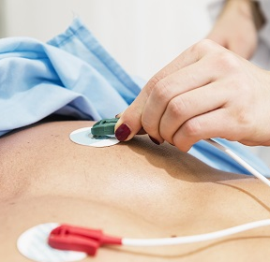
The Operating room
These stickers are called leads. They tell the doctors how your heart is doing. One goes on each side of your heart, and one goes on your tummy. These stickers do not hurt; they may feel cold and wet like a puppy dog nose
You will have a pulse ox bandaid around your finger again. It will test your breathing for the doctors

Slide 16
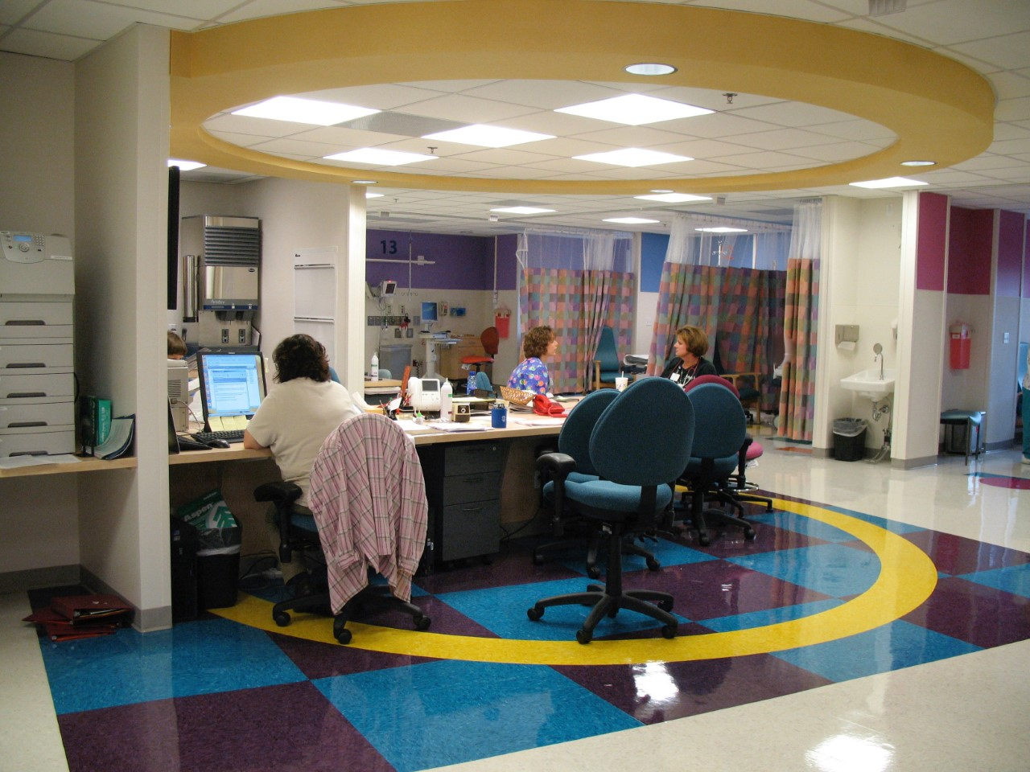
Recovery room
When your surgery is done, you will go to the recovery room. This is where you will start to wake up from your nap. Your family can see you again in the recovery room. You may hear other children as you wake up, or it may be quiet. A nurse will listen to your heart and give your arm a hug with the blood pressure cuff. If you feel sick or have any pain, you can tell the nurse and they will give you some medicine to help you feel better

Slide 17
After Surgery
When you are done in the recovery room, you will come back to the area where you started. Here you can rest and relax and will be able to eat and drink again. We have popsicles, crackers, juices, and sodas. Before you go home, the nurse will take the iv out of your hand. When the nurse takes your tape off, it will feel like taking a bandaid off. Then the nurse will put a bandaid over the spot where the iv was

Slide 18
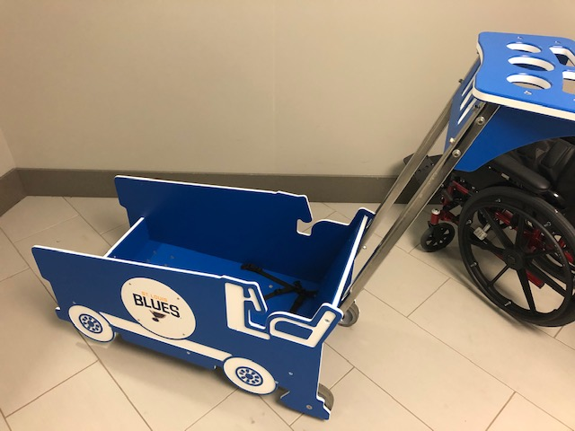
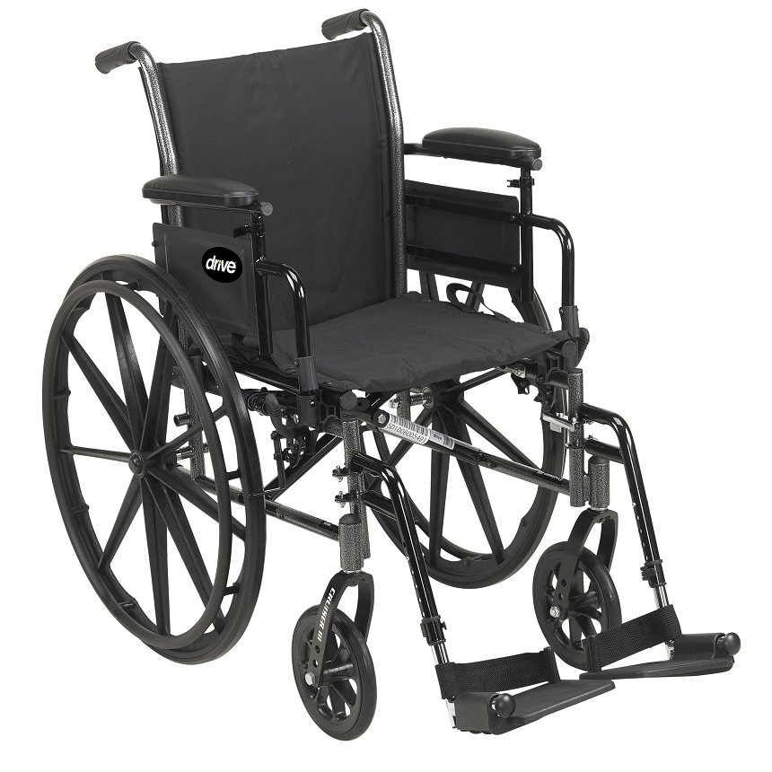
After Surgery
When the nurses are ready to send you home, you can either walk or ride in a wheelchair or wagon out to your car

Slide 19
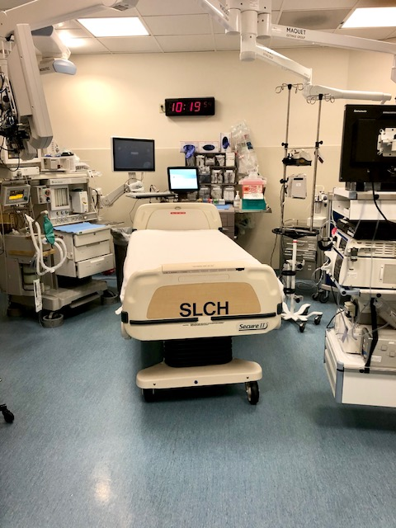
Procedure Room
The procedure room is where you will go for the doctors to take pictures of the inside of your body. There is a lot of equipment in this room, but not everything is used for you. We store lots of equipment in here so we have everything we need for every patient that comes to see us. The procedure room can be a little cool, so you will get a warm blanket to cover up with

Slide 20
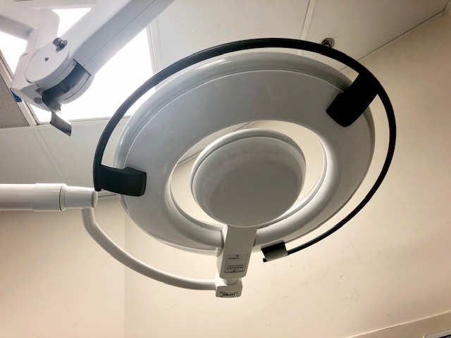
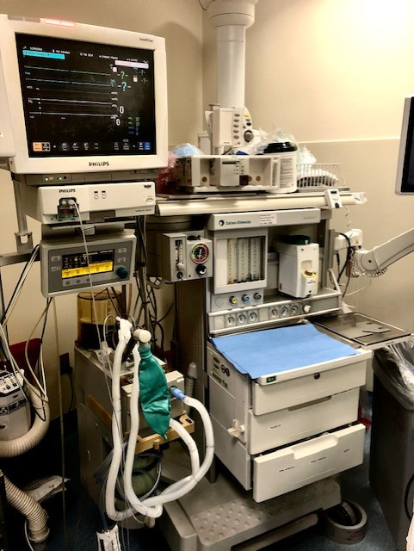
Procedure Room
You will see a big round light above your bed. This light help the doctors to see you better
This is the machine that gives you your sleepy medicine and helps the doctors know how you are doing while you sleep

Slide 21
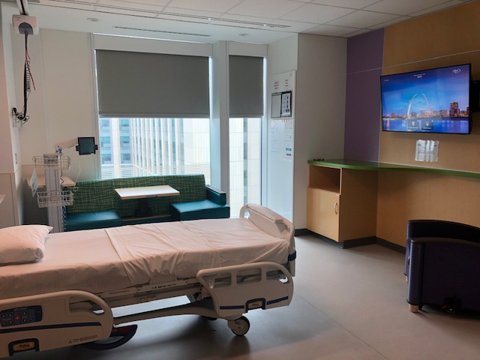
In-patient room
Your room will have a tv, a bathroom, and a place for someone to spend the night with you. You may or may not have your own room.

Slide 22
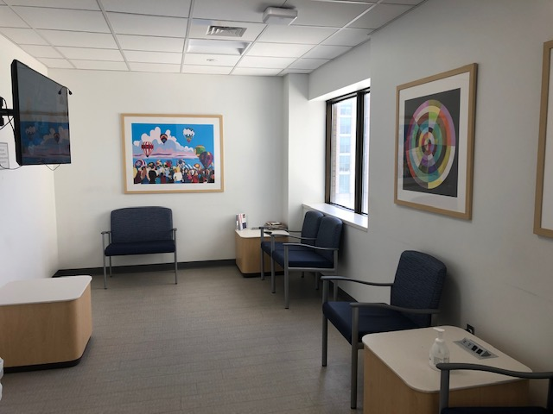
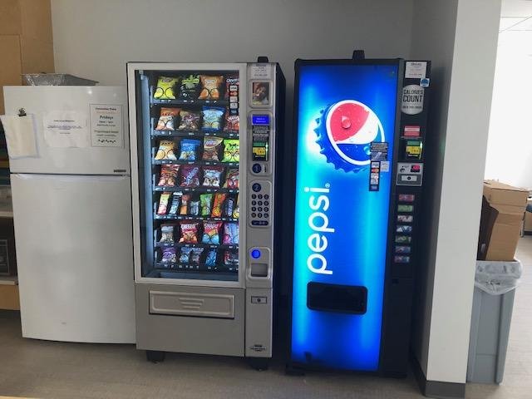
Family lounge
Inpatient units have family lounge areas where family members can take a break or use the shower area. These lounges also have vending machines and refrigerators where families can store their food

Slide 23
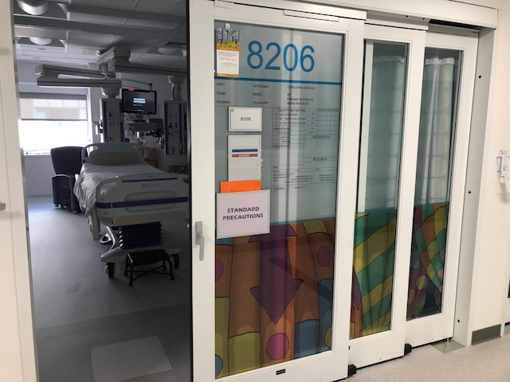
Pediatric intensive care unit
(PICU)
The picu is a unit where doctors and nurses give you extra special care to help make you better

Slide 24
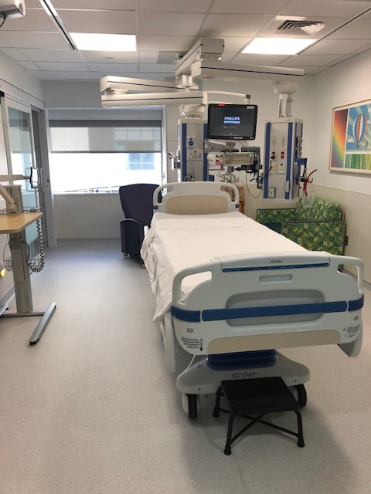
Pediatric intensive care unit
(PICU)
Your room has lots of computers by your bed that help make sure you are doing ok. It also has a tv, nursing call button, and chair for family members that visit you. If you have visitors who are under 16 years old, they will need special permission from the doctors and nurses to come visit you in the picu

Slide 25
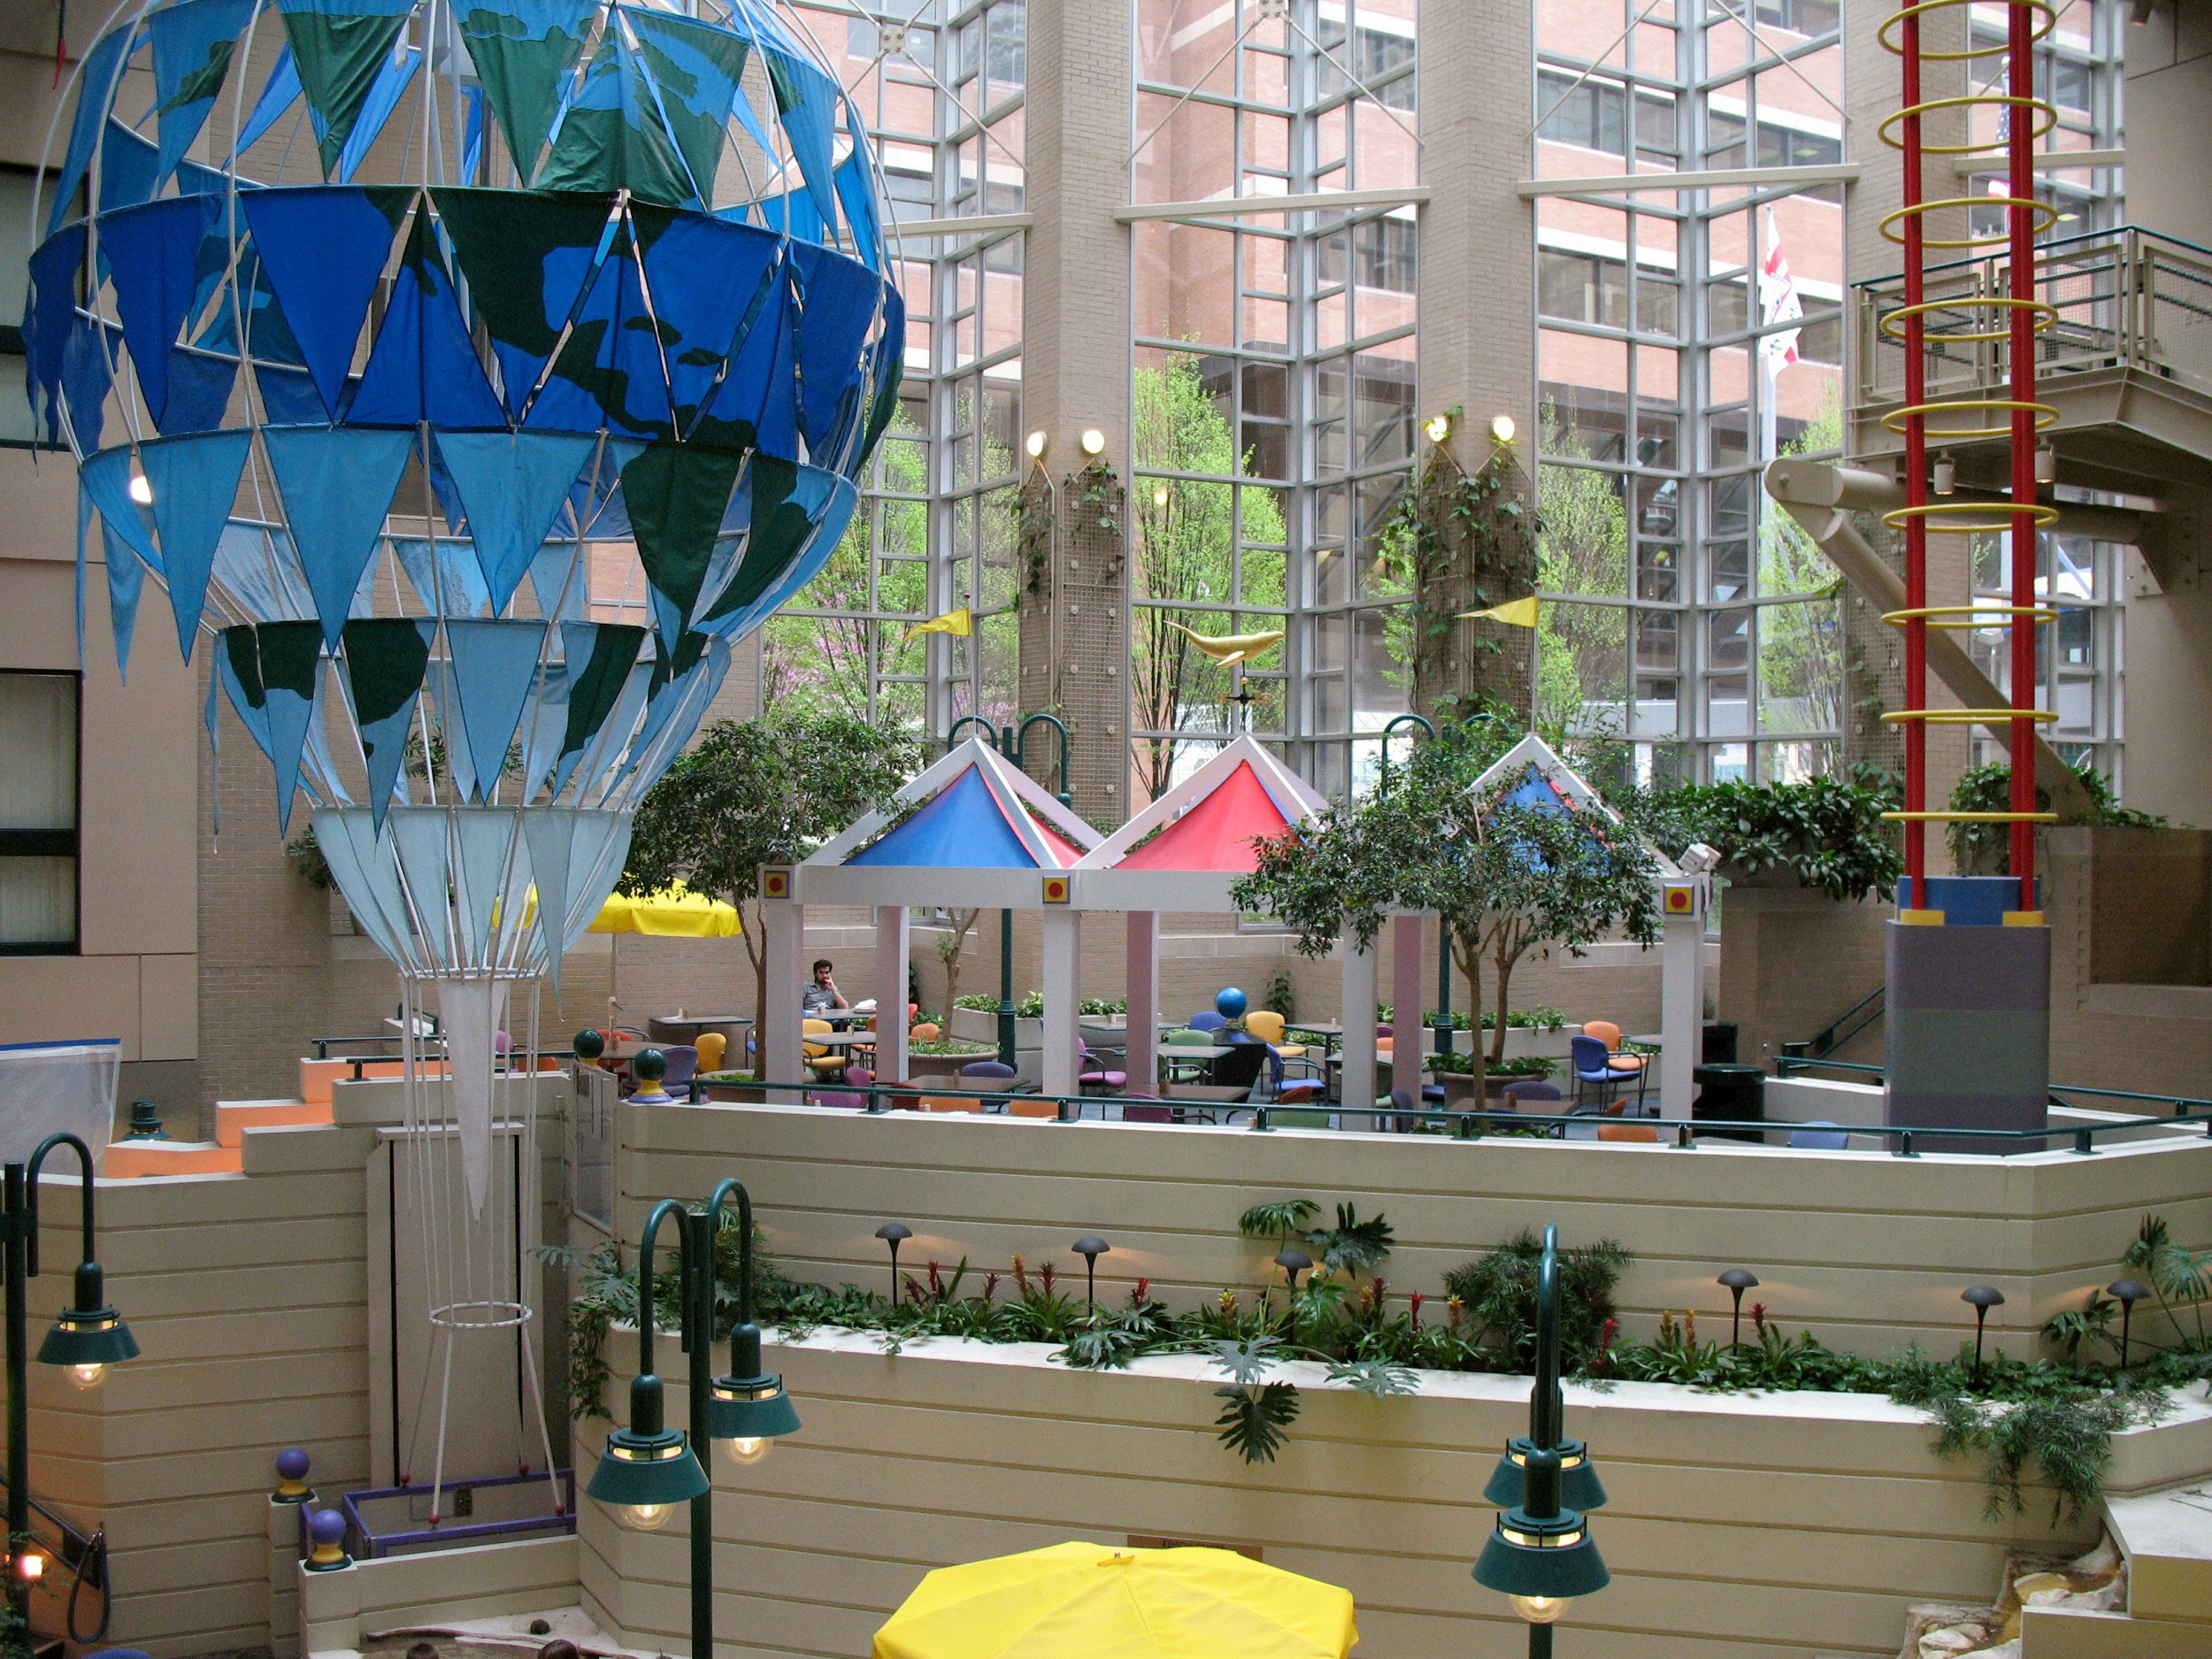
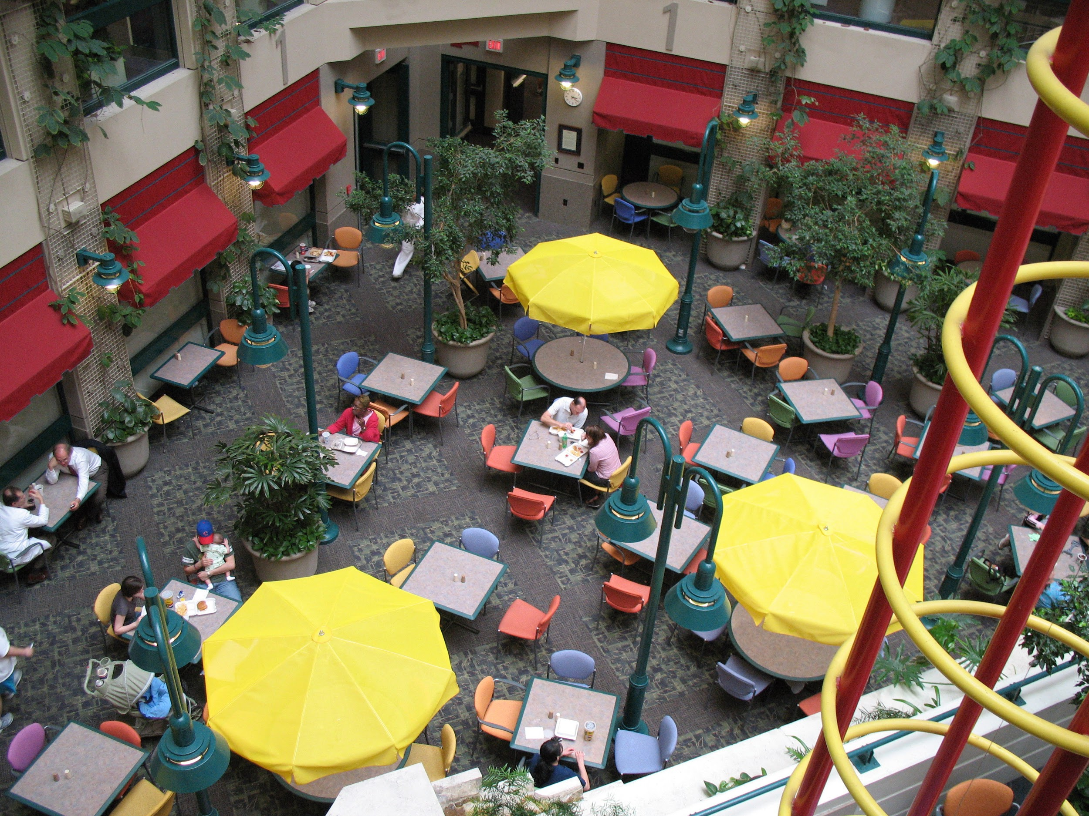
Fun places in the hospital
The cafeteria is located on the lower level. You can eat down there or bring food back to your room. You may also pick something off your room menu for meal times. If you come to the cafeteria, check out the big fish tank while you are there

Slide 26
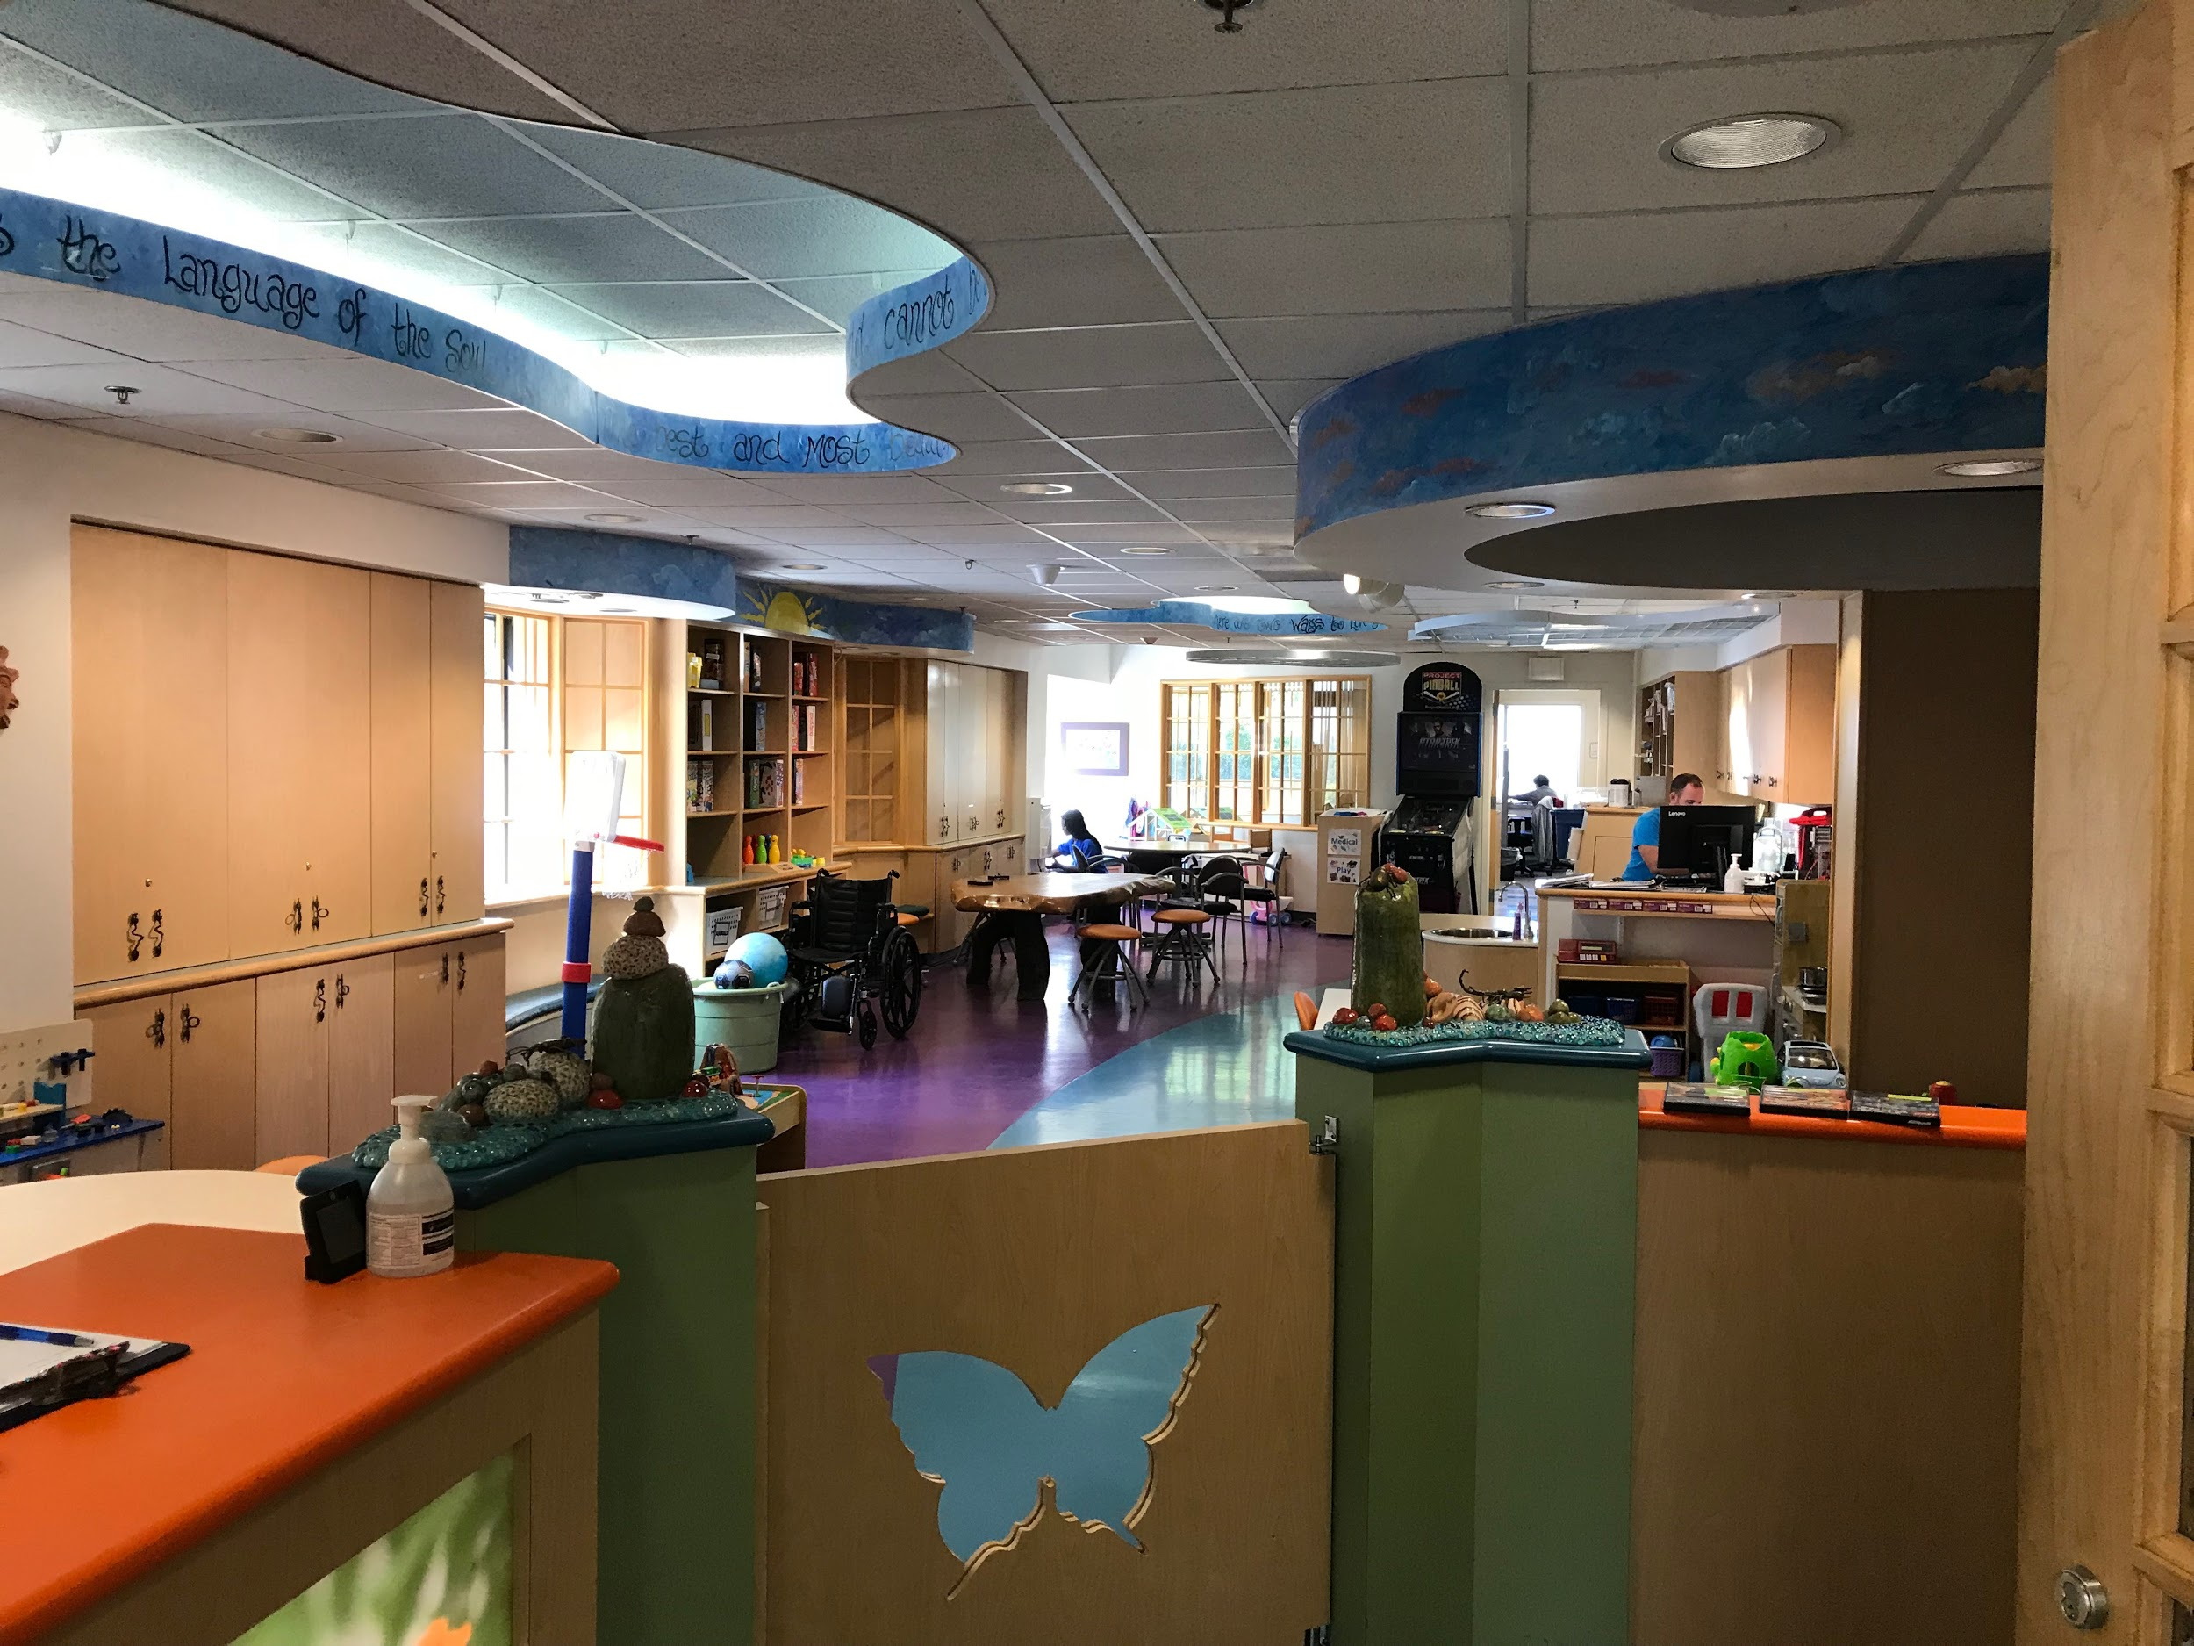
Fun places in the hospital
Our playroom is full of games, toys, and craft materials. If you can leave your room, come have some fun with other patients. If you need to stay in your room, we have many fun items that you can check out

Slide 27
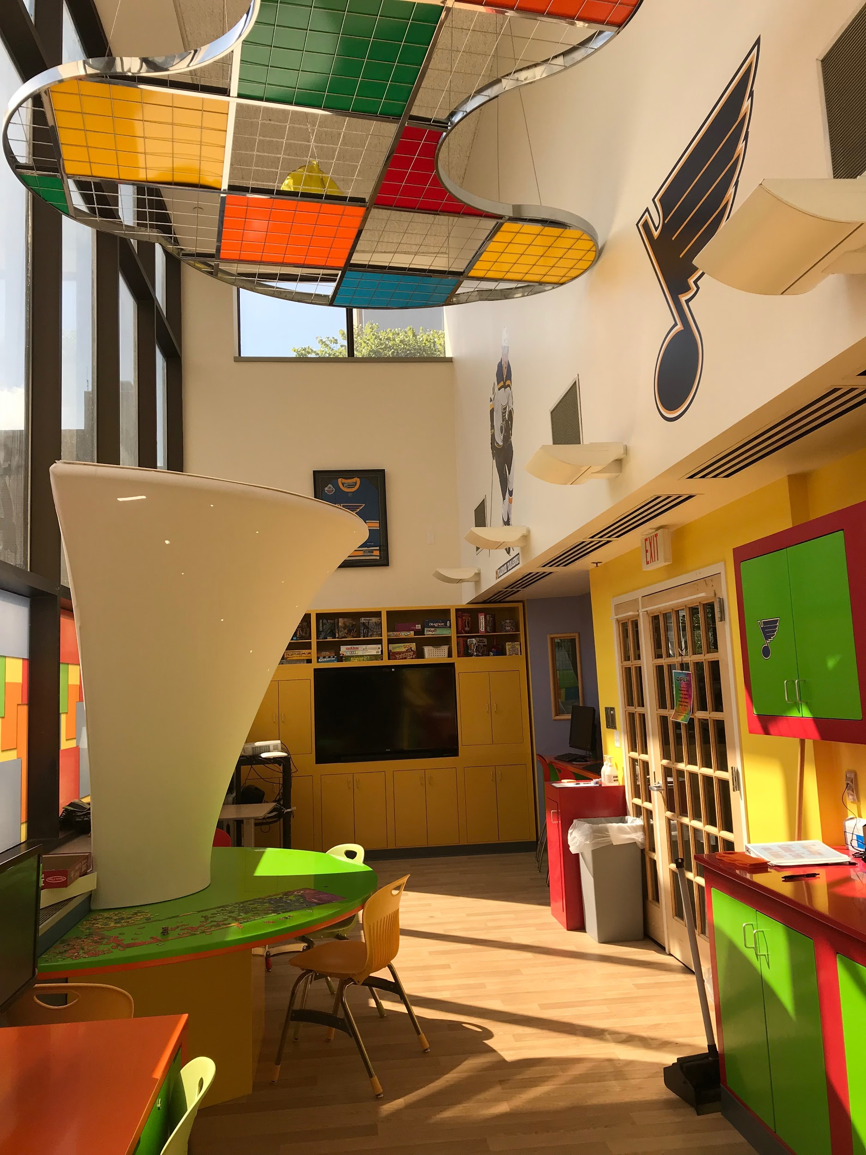
Fun places in the hospital
The teen lounge is for patients who are 12 years old and older. You can play games, watch tv, do crafts, or use a computer with other teens

Slide 28
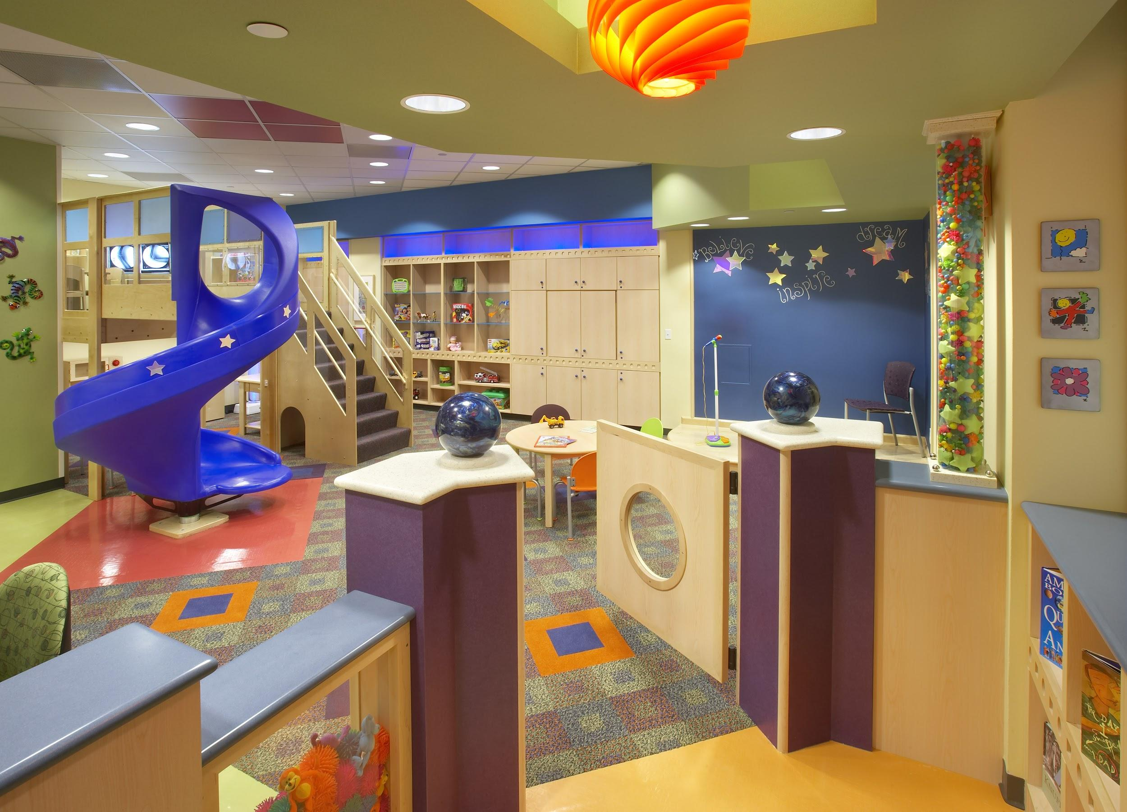
Fun places in the hospital
We have a sibling playroom available for siblings of patients that are admitted to the hospital. You might also visit this playroom if you come back for an outpatient appointment. This playroom is located on the lower level

Slide 29
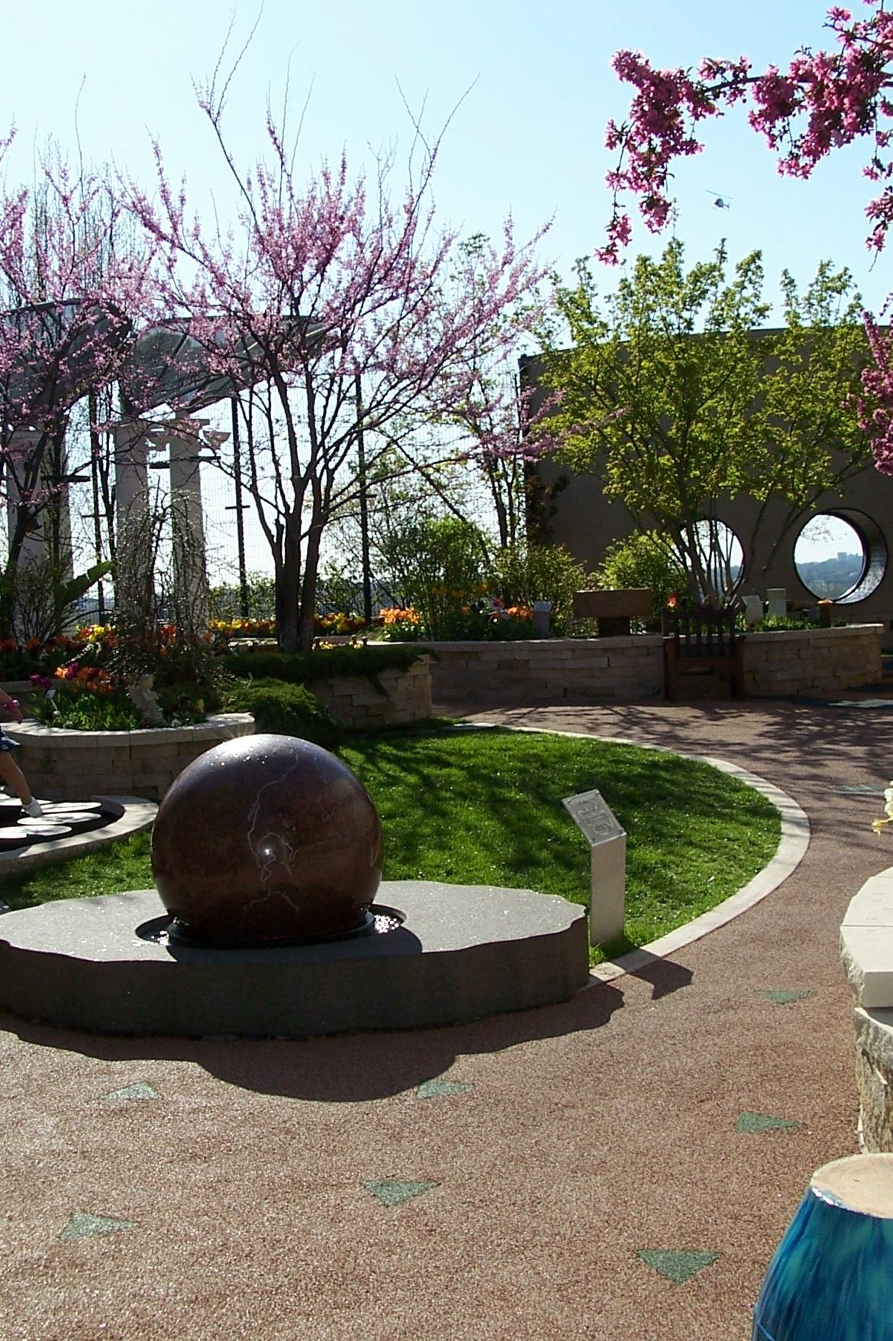
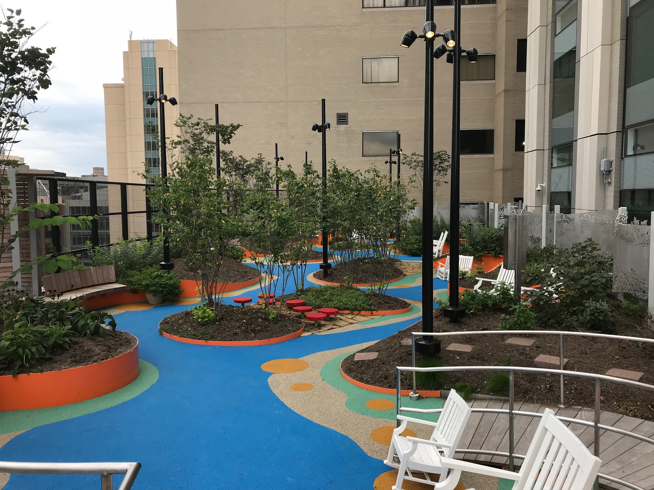
Fun places in the hospital
We have rooftop gardens on the 8th floor and 7th floor that you can explore if you are able to get out of your room

Slide 30
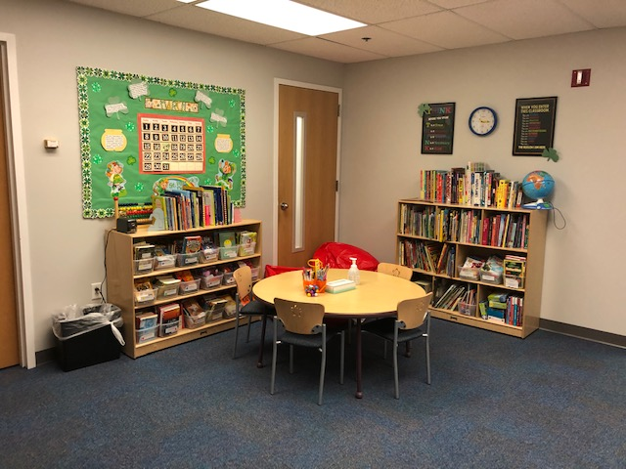
Fun places in the hospital
We have school teachers here that can help you stay on track with your school work if you have to stay for a long time. They will help you either in the school room or at your bedside

